Slide 1
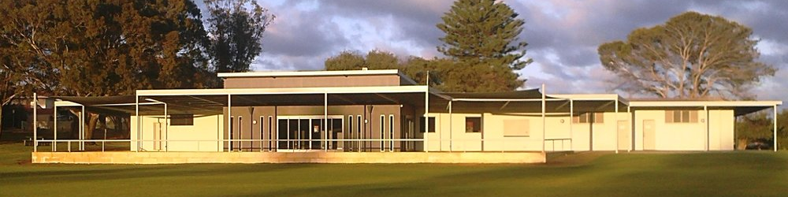
Dick Lawrence Game Day Field Set Up’s

Slide 2
Modified Field Set Up
All Gear in the store room behind the Home change rooms, open the roller door from the inside to access.
Oval will be marked with black paint
Insert metal goal post spikes on crosses at end of each ground
PVC Goal & Behind Posts go on top of spikes
Attach foam protectors onto real goal post at each end of full ground for safety
Mark out boundary using small plastic markers, using broken black line as reference

Slide 3
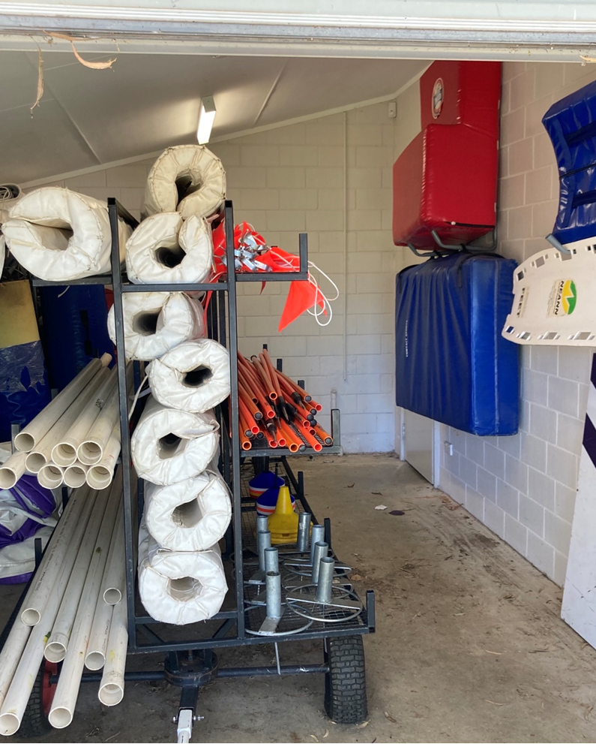
Gear Room
Left picture
Real Goal post protectors in the middle of trolly
1 Field set of Goals (2x sets of Goals) on bottom left shelf
1 Field set of goals (2x sets of Goals) on middle left shelf
Right Picture
1 Field set of Goal post spikes at one end of bottom shelf, other field set at other end of bottom shelf
2x sets (1 for each field) of coloured markers to mark complete outline of field which will be marked with a broken black line

Slide 4
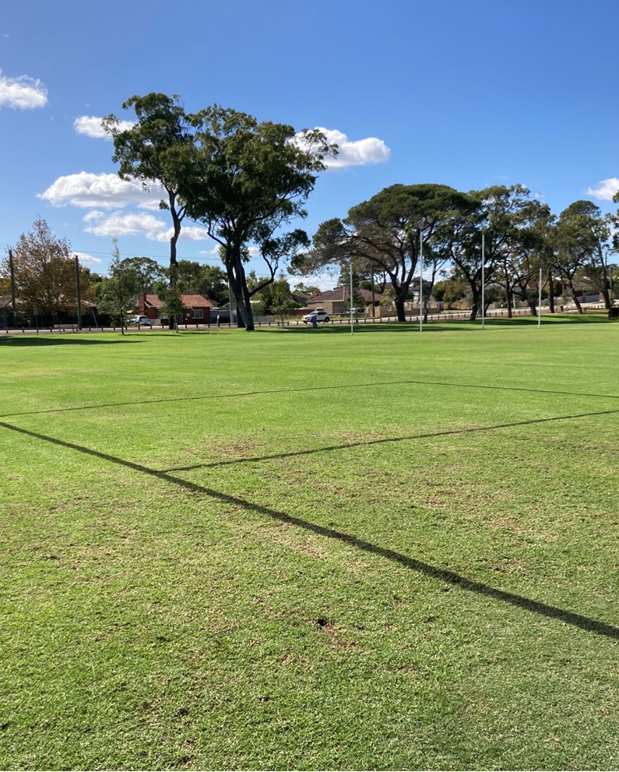
Modified Field Set Up
Modified fields marked in black paint
Goal square and solid black lines show wear goal posts need to be placed
Broken black line goes around the boundary that needs to be marked with coloured markers

Slide 5
Game Day – Full Field Set UP

Slide 6
Full Ovel Set Up
All gear in storage behind Home Changerooms
Purple Squares are New Marquees to be set up and nailed in for Coaches, Managers, First Aid et al.
White squares are existing metal frame shelters to be set up for players benches at each end and the interchange table in the middle
Orange Lines are interchange gate
Players and Official areas on each side to be roped off with bunting and pig tail spikes as shown in photos on following slides, will form a gate for players to enter and leave by removing the loop on the rope

Slide 7
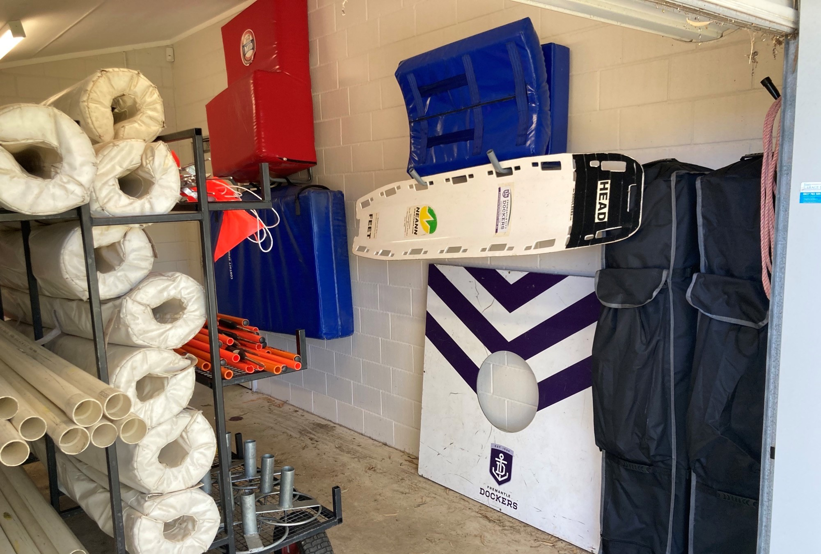
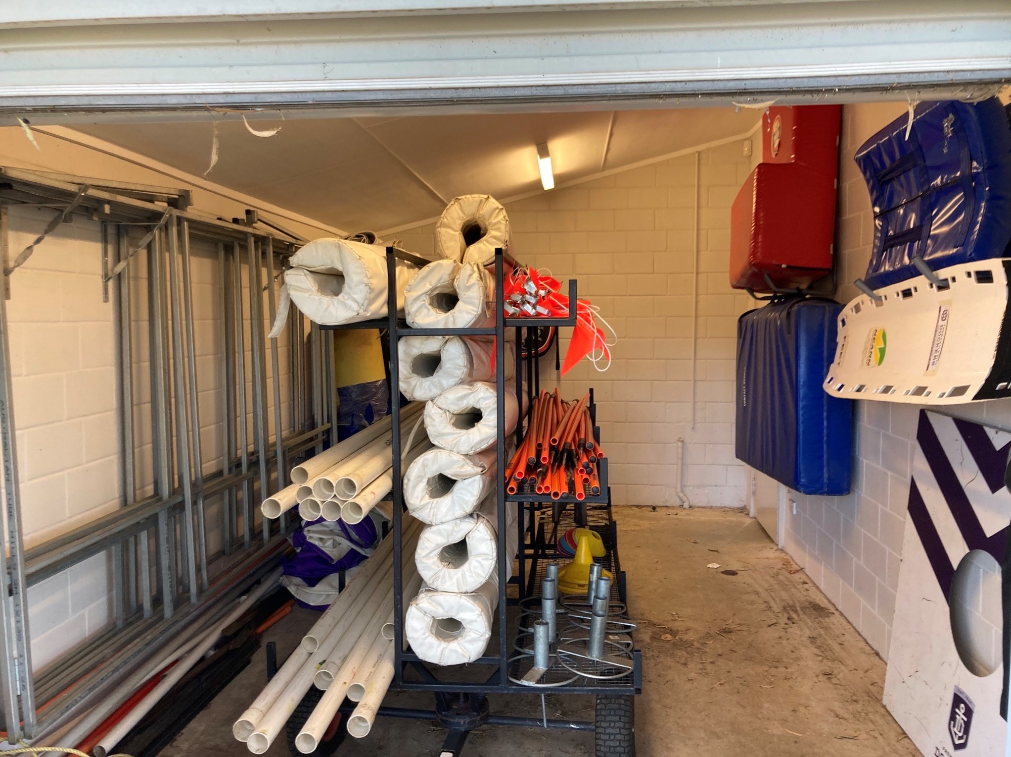
Gear Room
Left picture shows new Marquee’s in black bags and don’t forget to put the stretcher out
Right picture shows metal frame shelters on wall with the covers on the ground at the end, also pig tail spikes and bunting wrapped up in 2 sets on top right shelf of trolley
Yellow markers on bottom right shelf of trolley to mark interchange

Slide 8
